Slide 1
Minimum Spanning Tree

Slide 2
Spanning Trees
A spanning tree of a graph is just a subgraph that contains all the vertices and is a tree.
A graph may have many spanning trees.
Graph A
Some Spanning Trees from Graph A
or
or
or

Slide 3
Complete Graph
All 16 of its Spanning Trees

Slide 4
Minimum Spanning Trees
The Minimum Spanning Tree for a given graph is the Spanning Tree of minimum cost for that graph.
Complete Graph
Minimum Spanning Tree
7
2
2
5
3
3
4
1
1

Slide 5
Algorithms for Obtaining the Minimum Spanning Tree
Kruskal's Algorithm
Prim's Algorithm
Boruvka's Algorithm

Slide 6
Kruskal's Algorithm
This algorithm creates a forest of trees. Initially the forest consists of n single node trees (and no edges). At each step, we add one edge (the cheapest one) so that it joins two trees together. If it were to form a cycle, it would simply link two nodes that were already part of a single connected tree, so that this edge would not be needed.

Slide 7
The steps are:
1. The forest is constructed - with each node in a separate tree.
2. The edges are placed in a priority queue.
3. Until we've added n-1 edges,
1. Extract the cheapest edge from the queue,
2. If it forms a cycle, reject it,
3. Else add it to the forest. Adding it to the forest will join two trees together.
Every step will have joined two trees in the forest together, so that at the end, there will only be one tree in T.

Slide 8
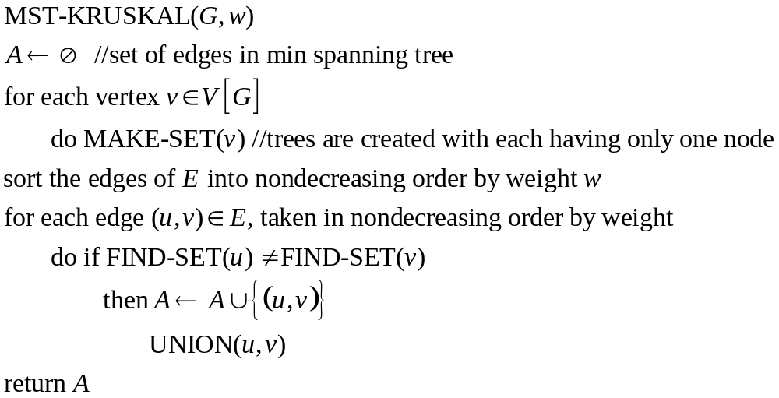
Algorithm

Slide 9
Complete Graph
B
4
C
4
2
1
A
4
E
1
F
D
2
3
10
G
5
5
6
3
4
I
H
2
3
J

Slide 10
A
4
B
A
1
D
B
4
C
B
4
D
B
4
C
B
10
J
C
2
E
4
2
1
C
1
F
D
5
H
A
4
E
1
F
2
D
6
J
E
2
G
D
3
10
G
5
F
3
G
F
5
I
5
6
3
4
I
G
3
I
G
4
J
H
2
3
J
H
2
J
I
3
J

Slide 11
Sort Edges
(in reality they are placed in a priority queue - not sorted - but sorting them makes the algorithm easier to visualize)
1
1
A
D
C
F
C
2
E
E
2
G
B
4
C
H
2
J
F
3
G
4
2
1
G
3
I
I
3
J
A
4
E
1
F
2
A
4
B
B
4
D
D
3
10
G
5
B
4
C
G
4
J
5
6
3
4
I
F
5
I
D
5
H
H
2
3
J
D
6
J
B
10
J

Slide 12
Add Edge
1
1
A
D
C
F
C
2
E
E
2
G
B
4
C
H
2
J
F
3
G
4
2
1
G
3
I
I
3
J
A
4
E
1
F
2
A
4
B
B
4
D
D
3
10
G
5
B
4
C
G
4
J
5
6
3
4
I
F
5
I
D
5
H
H
2
3
J
D
6
J
B
10
J

Slide 13
Add Edge
1
1
A
D
C
F
C
2
E
E
2
G
B
4
C
H
2
J
F
3
G
4
2
1
G
3
I
I
3
J
A
4
E
1
F
2
A
4
B
B
4
D
D
3
10
G
5
B
4
C
G
4
J
5
6
3
4
I
F
5
I
D
5
H
H
2
3
J
D
6
J
B
10
J

Slide 14
Add Edge
1
1
A
D
C
F
C
2
E
E
2
G
B
4
C
H
2
J
F
3
G
4
2
1
G
3
I
I
3
J
A
4
E
1
F
2
A
4
B
B
4
D
D
3
10
G
5
B
4
C
G
4
J
5
6
3
4
I
F
5
I
D
5
H
H
2
3
J
D
6
J
B
10
J

Slide 15
Add Edge
1
1
A
D
C
F
C
2
E
E
2
G
B
4
C
H
2
J
F
3
G
4
2
1
G
3
I
I
3
J
A
4
E
1
F
2
A
4
B
B
4
D
D
3
10
G
5
B
4
C
G
4
J
5
6
3
4
I
F
5
I
D
5
H
H
2
3
J
D
6
J
B
10
J

Slide 16
Add Edge
1
1
A
D
C
F
C
2
E
E
2
G
B
4
C
H
2
J
F
3
G
4
2
1
G
3
I
I
3
J
A
4
E
1
F
2
A
4
B
B
4
D
D
3
10
G
5
B
4
C
G
4
J
5
6
3
4
I
F
5
I
D
5
H
H
2
3
J
D
6
J
B
10
J

Slide 17
Cycle
Don’t Add Edge
1
1
A
D
C
F
C
2
E
E
2
G
B
4
C
H
2
J
F
3
G
4
2
1
G
3
I
I
3
J
A
4
E
1
F
2
A
4
B
B
4
D
D
3
10
G
5
B
4
C
G
4
J
5
6
3
4
I
F
5
I
D
5
H
H
2
3
J
D
6
J
B
10
J

Slide 18
Add Edge
1
1
A
D
C
F
C
2
E
E
2
G
B
4
C
H
2
J
F
3
G
4
2
1
G
3
I
I
3
J
A
4
E
1
F
2
A
4
B
B
4
D
D
3
10
G
5
B
4
C
G
4
J
5
6
3
4
I
F
5
I
D
5
H
H
2
3
J
D
6
J
B
10
J

Slide 19
Add Edge
1
1
A
D
C
F
C
2
E
E
2
G
B
4
C
H
2
J
F
3
G
4
2
1
G
3
I
I
3
J
A
4
E
1
F
2
A
4
B
B
4
D
D
3
10
G
5
B
4
C
G
4
J
5
6
3
4
I
F
5
I
D
5
H
H
2
3
J
D
6
J
B
10
J

Slide 20
Add Edge
1
1
A
D
C
F
C
2
E
E
2
G
B
4
C
H
2
J
F
3
G
4
2
1
G
3
I
I
3
J
A
4
E
1
F
2
A
4
B
B
4
D
D
3
10
G
5
B
4
C
G
4
J
5
6
3
4
I
F
5
I
D
5
H
H
2
3
J
D
6
J
B
10
J

Slide 21
Cycle
Don’t Add Edge
1
1
A
D
C
F
C
2
E
E
2
G
B
4
C
H
2
J
F
3
G
4
2
1
G
3
I
I
3
J
A
4
E
1
F
2
A
4
B
B
4
D
D
3
10
G
5
B
4
C
G
4
J
5
6
3
4
I
F
5
I
D
5
H
H
2
3
J
D
6
J
B
10
J

Slide 22
Add Edge
1
1
A
D
C
F
C
2
E
E
2
G
B
4
C
H
2
J
F
3
G
4
2
1
G
3
I
I
3
J
A
4
E
1
F
2
A
4
B
B
4
D
D
3
10
G
5
B
4
C
G
4
J
5
6
3
4
I
F
5
I
D
5
H
H
2
3
J
D
6
J
B
10
J

Slide 23
Minimum Spanning Tree
Complete Graph
B
4
C
4
B
C
4
4
2
1
2
1
A
E
A
4
1
F
E
F
1
D
2
2
D
3
10
G
G
5
3
5
6
3
4
I
I
H
H
2
3
3
J
2
J

Slide 24
Analysis of Kruskal's Algorithm
Running Time = O(m log n) (m = edges, n = nodes)
Testing if an edge creates a cycle can be slow unless a complicated data structure called a “union-find” structure is used.
It usually only has to check a small fraction of the edges, but in some cases (like if there was a vertex connected to the graph by only one edge and it was the longest edge) it would have to check all the edges.
This algorithm works best, of course, if the number of edges is kept to a minimum.

Slide 25
Prim's Algorithm
This algorithm starts with one node. It then, one by one, adds a node that is unconnected to the new graph, each time selecting the node whose connecting edge has the smallest weight out of the available nodes’ connecting edges.

Slide 26
The steps are:
1. The new graph is constructed - with one node from the old graph.
2. While new graph has fewer than n nodes,
1. Find the node from the old graph with the smallest connecting edge to the new graph,
2. Add it to the new graph
Every step will have joined one node, so that at the end we will have one graph with all the nodes and it will be a minimum spanning tree of the original graph.

Slide 27
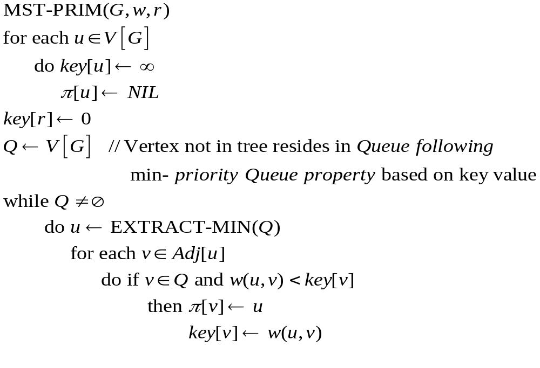
Algorithm

Slide 28
Complete Graph
B
4
C
4
2
1
A
4
E
1
F
D
2
3
10
G
5
5
6
3
4
I
H
2
3
J

Slide 29
Old Graph
New Graph
B
4
C
4
B
4
C
2
1
4
2
1
A
4
E
1
F
A
4
E
F
1
D
2
3
10
D
2
3
G
5
10
G
5
5
6
3
5
6
3
4
I
4
H
I
3
H
2
J
2
3
J

Slide 30
Old Graph
New Graph
B
4
C
4
B
4
C
2
1
4
2
1
A
4
E
1
F
A
4
E
F
1
D
2
3
10
D
2
3
G
5
10
G
5
5
6
3
5
6
3
4
I
4
H
I
3
H
2
J
2
3
J

Slide 31
Old Graph
New Graph
B
4
C
4
B
4
C
2
1
4
2
1
A
4
E
1
F
A
4
E
F
1
D
2
3
10
D
2
3
G
5
10
G
5
5
6
3
5
6
3
4
I
4
H
I
3
H
2
J
2
3
J

Slide 32
Old Graph
New Graph
B
4
C
4
B
4
C
2
1
4
2
1
A
4
E
1
F
A
4
E
F
1
D
2
3
10
D
2
3
G
5
10
G
5
5
6
3
5
6
3
4
I
4
H
I
3
H
2
J
2
3
J

Slide 33
Old Graph
New Graph
B
4
C
4
B
4
C
2
1
4
2
1
A
4
E
1
F
A
4
E
F
1
D
2
3
10
D
2
3
G
5
10
G
5
5
6
3
5
6
3
4
I
4
H
I
3
H
2
J
2
3
J

Slide 34
Old Graph
New Graph
B
4
C
4
B
4
C
2
1
4
2
1
A
4
E
1
F
A
4
E
F
1
D
2
3
10
D
2
3
G
5
10
G
5
5
6
3
5
6
3
4
I
4
H
I
3
H
2
J
2
3
J

Slide 35
Old Graph
New Graph
B
4
C
4
B
4
C
2
1
4
2
1
A
4
E
1
F
A
4
E
F
1
D
2
3
10
D
2
3
G
5
10
G
5
5
6
3
5
6
3
4
I
4
H
I
3
H
2
J
2
3
J

Slide 36
Old Graph
New Graph
B
4
C
4
B
4
C
2
1
4
2
1
A
4
E
1
F
A
4
E
F
1
D
2
3
10
D
2
3
G
5
10
G
5
5
6
3
5
6
3
4
I
4
H
I
3
H
2
J
2
3
J

Slide 37
Old Graph
New Graph
B
4
C
4
B
4
C
2
1
4
2
1
A
4
E
1
F
A
4
E
F
1
D
2
3
10
D
2
3
G
5
10
G
5
5
6
3
5
6
3
4
I
4
H
I
3
H
2
J
2
3
J

Slide 38
Old Graph
New Graph
B
4
C
4
B
4
C
2
1
4
2
1
A
4
E
1
F
A
4
E
F
1
D
2
3
10
D
2
3
G
5
10
G
5
5
6
3
5
6
3
4
I
4
H
I
3
H
2
J
2
3
J

Slide 39
Complete Graph
Minimum Spanning Tree
B
4
C
4
B
4
C
2
1
4
2
1
A
4
E
1
F
A
E
F
1
D
2
3
10
D
2
G
5
G
5
6
3
3
4
I
H
I
3
H
2
J
2
3
J

Slide 40
Analysis of Prim's Algorithm
Running Time = O(m + n log n) (m = edges, n = nodes)
If a heap is not used, the run time will be O(n^2) instead of
O(m + n log n). However, using a heap complicates the code since you’re complicating the data structure. A Fibonacci heap is the best kind of heap to use, but again, it complicates the code.
Unlike Kruskal’s, it doesn’t need to see all of the graph at once. It can deal with it one piece at a time. It also doesn’t need to worry if adding an edge will create a cycle since this algorithm deals primarily with the nodes, and not the edges.
For this algorithm the number of nodes needs to be kept to a minimum in addition to the number of edges. For small graphs, the edges matter more, while for large graphs the number of nodes matters more.

Slide 41
Boruvka's Algorithm
This algorithm is similar to Prim’s, but nodes are added to the new graph in parallel all around the graph. It creates a list of trees, each containing one node from the original graph and proceeds to merge them along the smallest-weight connecting edges until there’s only one tree, which is, of course, the MST. It works rather like a merge sort.

Slide 42
The steps are:
1. Make a list of n trees, each containing a single node
2. While list has more than one tree,
1. For each tree in the list, find the node not connected to the tree with the smallest connecting edge to that tree,
2. Add all the edges found to the new graph, thus creating a new set of trees
Every step will have joined groups of trees, until only one tree remains.

Slide 43
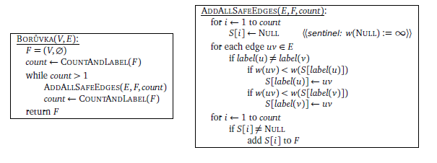
Algorithm

Slide 44
Complete Graph
B
4
C
4
2
1
A
4
E
1
F
D
2
3
10
G
5
5
6
3
4
I
H
2
3
J

Slide 45
Trees of the Graph at Beginning of Round 1
List of Trees
4
A
B
C
D
E
F
G
H
I
J
B
C
4
2
1
A
4
E
1
F
D
2
3
10
G
5
5
6
3
4
I
H
2
3
J

Slide 46
Round 1
Tree A
B
4
C
B
4
4
2
1
A
4
E
A
1
F
1
D
2
3
D
10
G
5
5
6
3
4
I
H
2
3
J

Slide 47
Round 1
Edge A-D
B
4
C
B
4
4
2
1
A
4
E
A
1
F
1
D
2
3
D
10
G
5
5
6
3
4
I
H
2
3
J

Slide 48
Round 1
Tree B
B
4
C
4
B
C
4
4
2
1
A
4
E
A
4
1
F
D
2
3
D
10
10
G
5
5
6
3
4
I
H
2
3
J
J

Slide 49
Round 1
Edge B-A
B
4
C
4
B
C
4
4
2
1
A
4
E
A
4
1
F
D
2
3
D
10
10
G
5
5
6
3
4
I
H
2
3
J
J

Slide 50
Round 1
Tree C
B
4
C
4
B
C
4
2
1
2
1
A
4
E
1
F
E
F
D
2
3
10
G
5
5
6
3
4
I
H
2
3
J

Slide 51
Round 1
Edge C-F
B
4
C
4
B
C
4
2
1
2
1
A
4
E
1
F
E
F
D
2
3
10
G
5
5
6
3
4
I
H
2
3
J

Slide 52
Round 1
Tree D
B
4
C
B
4
2
1
A
4
E
A
4
1
F
1
D
2
3
D
10
G
5
5
6
3
5
6
4
I
H
H
2
3
J
J

Slide 53
Round 1
Edge D-A
B
4
C
B
4
2
1
A
4
E
A
4
1
F
1
D
2
3
D
10
G
5
5
6
3
5
6
4
I
H
H
2
3
J
J

Slide 54
Round 1
Tree E
B
4
C
C
4
2
1
2
A
4
E
1
F
E
D
2
3
2
10
G
5
G
5
6
3
4
I
H
2
3
J

Slide 55
Round 1
Edge E-C
B
4
C
C
4
2
1
2
A
4
E
1
F
E
D
2
3
2
10
G
5
G
5
6
3
4
I
H
2
3
J

Slide 56
Round 1
Tree F
B
4
C
C
4
2
1
1
A
4
E
1
F
F
D
2
3
3
10
G
5
5
G
5
6
3
4
I
I
H
2
3
J

Slide 57
Round 1
Edge F-C
B
4
C
C
4
2
1
1
A
4
E
1
F
F
D
2
3
3
10
G
5
5
G
5
6
3
4
I
I
H
2
3
J

Slide 58
Round 1
Tree G
B
4
C
4
2
1
A
4
E
1
F
E
F
D
2
3
2
3
10
G
5
G
5
6
3
3
4
4
I
I
H
2
3
J
J

Slide 59
Round 1
Edge G-E
B
4
C
4
2
1
A
4
E
1
F
E
F
D
2
3
2
3
10
G
5
G
5
6
3
3
4
4
I
I
H
2
3
J
J

Slide 60
Round 1
Tree H
B
4
C
4
2
1
A
4
E
1
F
D
2
3
D
10
G
5
5
6
3
5
4
I
H
H
2
3
J
2
J

Slide 61
Round 1
Edge H-J
B
4
C
4
2
1
A
4
E
1
F
D
2
3
D
10
G
5
5
6
3
5
4
I
H
H
2
3
J
2
J

Slide 62
Round 1
Tree I
B
4
C
4
2
1
A
4
E
1
F
F
D
2
3
10
G
5
5
G
5
6
3
3
4
I
I
H
2
3
3
J
J

Slide 63
Round 1
Edge I-G
B
4
C
4
2
1
A
4
E
1
F
F
D
2
3
10
G
5
5
G
5
6
3
3
4
I
I
H
2
3
3
J
J

Slide 64
Round 1
Tree J
B
4
C
B
4
2
1
A
4
E
1
F
D
2
3
D
10
10
G
5
G
5
6
3
6
4
4
I
I
H
H
2
3
3
J
2
J

Slide 65
Round 1
Edge J-H
B
4
C
B
4
2
1
A
4
E
1
F
D
2
3
D
10
10
G
5
G
5
6
3
6
4
4
I
I
H
H
2
3
3
J
2
J

Slide 66
Round 1 Ends - Add Edges
List of Edges to Add
4
A-D
B-A
C-F
D-A
E-C
F-C
G-E
H-J
I-G
J-H
B
C
4
2
1
A
4
E
1
F
D
2
3
10
G
5
5
6
3
4
I
H
2
3
J

Slide 67
Trees of the Graph at Beginning of Round 2
List of Trees
4
D-A-B
F-C-E-G-I
H-J
B
C
4
2
1
A
4
E
1
F
D
2
3
10
G
5
5
6
3
4
I
H
2
3
J

Slide 68
Round 2
Tree D-A-B
B
4
C
4
B
C
4
4
2
1
2
1
A
4
E
A
4
1
F
E
F
1
D
2
3
2
D
10
10
G
5
G
5
6
3
5
6
3
4
I
I
H
H
2
3
J
2
J

Slide 69
Round 2
Edge B-C
B
4
C
4
B
C
4
4
2
1
2
1
A
4
E
A
4
1
F
E
F
1
D
2
3
2
D
10
10
G
5
G
5
6
3
5
6
3
4
I
I
H
H
2
3
J
2
J

Slide 70
Round 2
Tree F-C-E-G-I
B
4
C
4
B
C
4
4
2
1
2
1
A
4
E
A
1
F
E
F
1
D
2
3
2
D
3
10
G
5
5
G
5
6
3
3
4
4
I
I
H
H
2
3
3
J
2
J

Slide 71
Round 2
Edge I-J
B
4
C
4
B
C
4
4
2
1
2
1
A
4
E
A
1
F
E
F
1
D
2
3
2
D
3
10
G
5
5
G
5
6
3
3
4
4
I
I
H
H
2
3
3
J
2
J

Slide 72
Round 2
Tree H-J
B
4
C
B
C
4
4
2
1
2
1
A
4
E
A
1
F
E
F
1
D
2
3
2
D
10
10
G
5
G
5
6
3
5
6
3
4
4
I
I
H
H
2
3
3
J
2
J

Slide 73
Round 2
Edge J-I
B
4
C
B
C
4
4
2
1
2
1
A
4
E
A
1
F
E
F
1
D
2
3
2
D
10
10
G
5
G
5
6
3
5
6
3
4
4
I
I
H
H
2
3
3
J
2
J

Slide 74
Round 2 Ends - Add Edges
List of Edges to Add
4
B-C
I-J
J-I
B
C
4
2
1
A
4
E
1
F
D
2
3
10
G
5
5
6
3
4
I
H
2
3
J

Slide 75
Minimum Spanning Tree
Complete Graph
B
4
C
4
B
C
4
4
2
1
2
1
A
E
A
4
1
F
E
F
1
D
2
2
D
3
10
G
G
5
3
5
6
3
4
I
I
H
H
2
3
3
J
2
J

Slide 76
Analysis of Boruvka's Algorithm
Running Time = O(m log n) (m = edges, n = nodes)
Although this algorithm is difficult to explain, unlike the two preceding algorithms, it does not require a complicated data structure.
Like Prim’s, it does not need to worry about detecting cycles. It does, however, need to see the whole graph, but it only examines pieces of it at a time, not all of it at once.
Like Kruskal’s it is best if edges are kept to a minimum (though it doesn’t hurt to keep the nodes to a minimum as well).

Slide 77
Conclusion
Kruskal’s and Boruvka’s have better running times if the number of edges is low, while Prim’s has a better running time if both the number of edges and the number of nodes are low.
Boruvka’s avoids the complicated data structures needed for the other two algorithms.
So, of course, the best algorithm depends on the graph and if you want to bear the cost of complex data structures.
The best algorithm that I know of is a hybrid of Boruvka’s and Prim’s, which I did not examine here. It does O(log log n) passes of Boruvka’s and then switches to Prim’s, resulting in a running time of O(m log log n). So, it’s the fastest algorithm, but would, of course, require the Fibonacci heap for Prim’s which Boruvka’s avoids when used by itself. However, in order to keep things simple, I did not explore it here.

